Slide 1
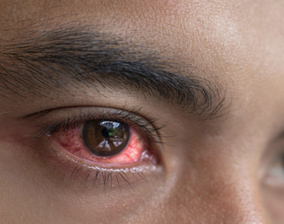
Landing page = index.html
- Overview of eye diseases description, definition, kinds etc.
Eye Diseases:
Left VS Right Eye Diagnostic
Gender
Age
Additional Resources and Information

Slide 2
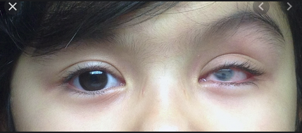
Back to Main
Left VS Right Eye Diagnostic:
Left or Right eye prevalence?
How many have more than just one?

Slide 3
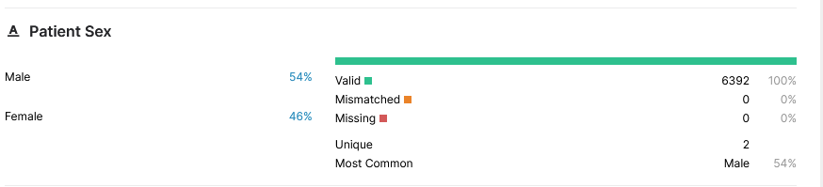
Gender:
Back to Main
Do Males or Females have higher rates of eye disease?
The most common reason for diagnosed eye disease?

Slide 4
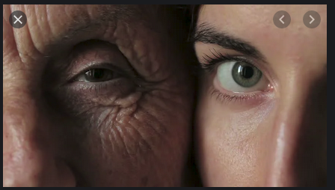
Age:
Back to Main
What age is most prevalent young or old?
The most common reason for diagnosed eye disease?

Slide 5
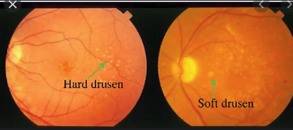
Different kinds of eye diseases:
Back to Main
Normal (N),
Diabetes (D),
Glaucoma (G),
Cataract (C),
Age related Macular Degeneration (A),
Hypertension (H),
Pathological Myopia (M),
Other diseases/abnormalities (O)

Slide 6
Information about potential Prevention and Treatments:
Back to Main
Here are links for further study about fixing your eye boogers

